Slide 1
Lecture 19 – Recursion
Recursion function, factorial function, Fibonacci function
Kok-Seng Wong | 2021

Slide 2
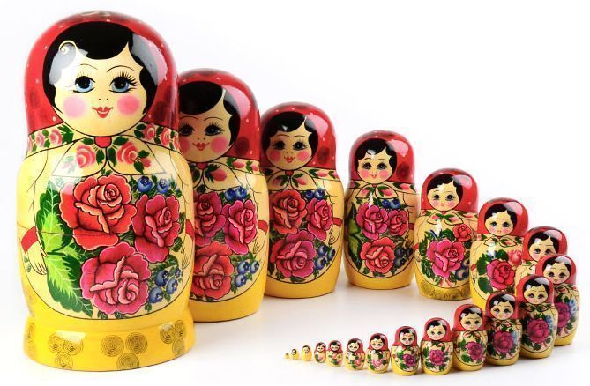
Motivation example 1
Russian Nesting Dolls
[Source]

Slide 3
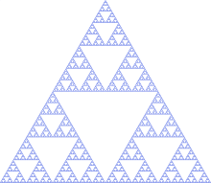


Motivation example 2
Sierpiński Triangle
[Source]

Slide 4
Learning outcomes
Upon the completion of this lecture, students will be able to:
describe the concept of recursion and give examples of its use.
understand recursion and how to develop recursive algorithms and programs.
compare iterative and recursive solutions.

Slide 5
Recursion idea
Recursion: a powerful programming and problem-solving tool.
A process for solving problems by subdividing a larger problem into smaller cases of the problem itself and then solving the smaller, more trivial parts.
Recursion solutions are not always the most efficient one.
recursion
recursion
recursion
recursion
recursion
recursion
recursion

Slide 6
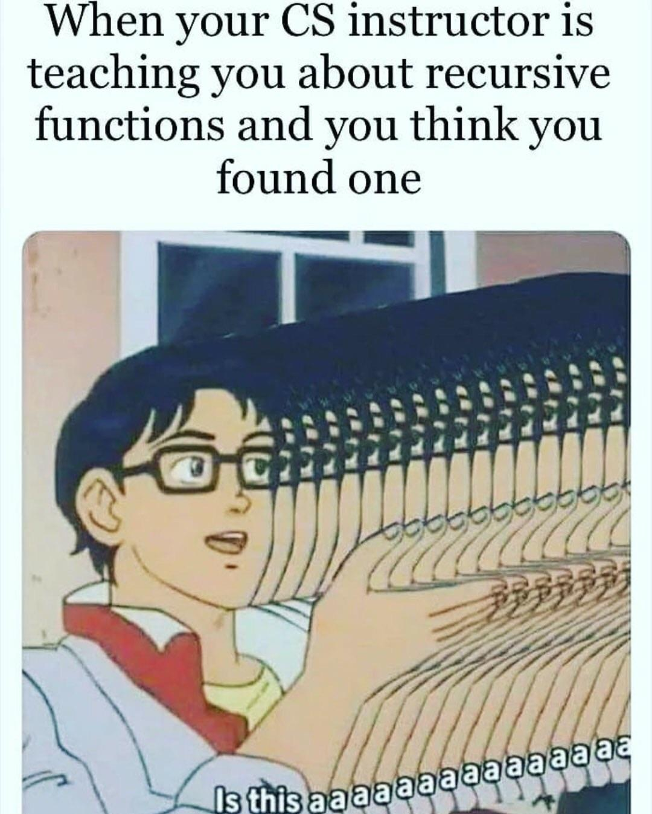
[source]

Slide 7
Properties of Recursion
A recursive definition consists of:
A base case: the part of the definition that cannot be expressed in terms of smaller versions of itself.
One or more base cases to provide stopping condition of the recursion.
A recursive case: the part of the definition that can be expressed in terms of smaller versions of itself.
A recursive solution must make progress toward the base case.

Slide 8
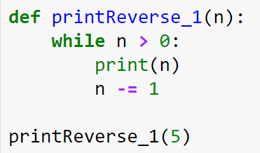
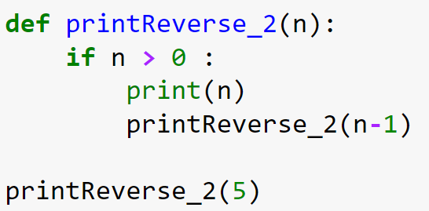
Recursive functions
Recursive function: a function that calls itself.
While-loop
Recursive function

Slide 9
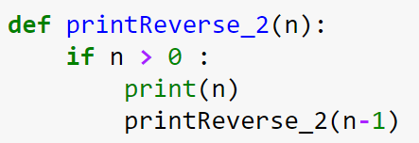
Recursive flow of execution
n = 5
printReverse_2(5)
5
n = 4
4
3
2
n = 3
1
n = 2
n = 1
n = 0
[Demo]

Slide 10
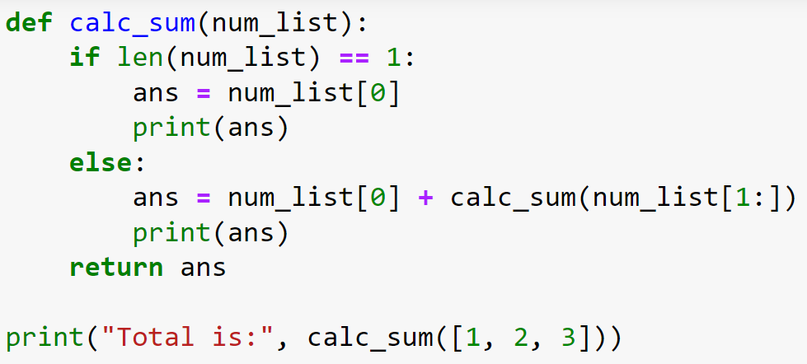
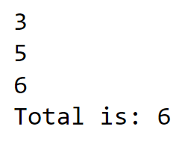
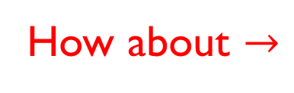
Recursive example 1
How about $→$

Slide 11
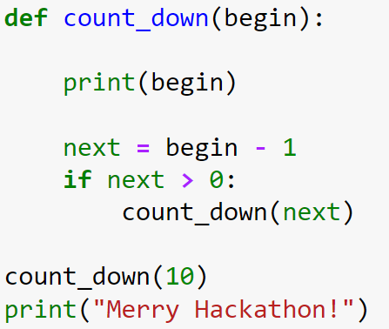
Class practice

Slide 12
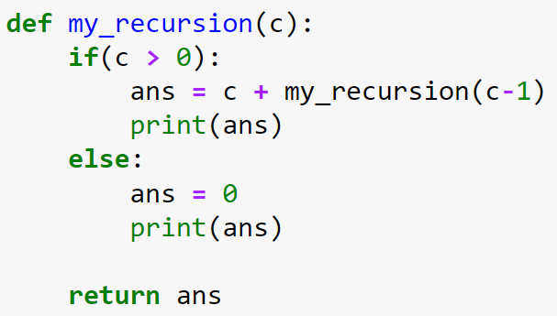
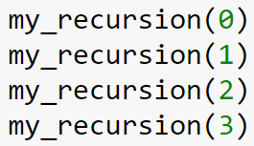
Class practice

Slide 13
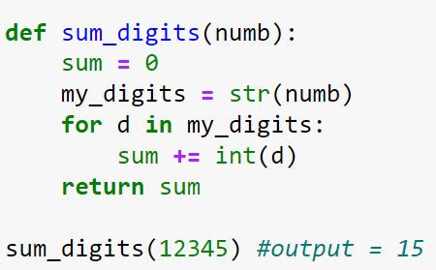
Group discussion
Iterative Method: Recursive Method:

Slide 14
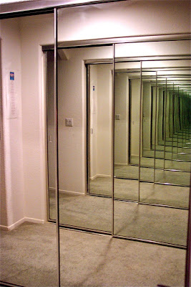
Infinite recursion
When failed to specify base case
or failed to reduce size of problem to terminate the recursive process
[Source]

Slide 15
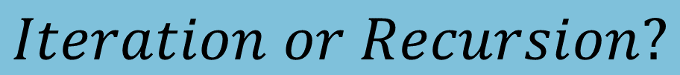
Iteration vs recursion
Similarity: both repeat block of codes
Differences:
Iteration – use loop (e.g., for-loop or while-loop) to repeat the block of codes
Recursion – call itself to repeat the block of codes
Iteration terminates based on the loop condition
Recursion terminates based on the base case
$$Iteration or Recursion?$$

Slide 16
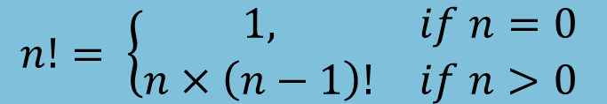

Factorial
Factorial function, $n! = n ×\left(n−1\right)×\left(n−2\right)×…×1$
Example:
0! = 1
1! = 1
2! = 2 x 1
3! = 3 x 2 x 1
4! = 4 x 3 x 2 x 1
5! = 5 x 4 x 3x 2 x 1
0! = 1
1! = 1 (1 - 1)!
2! = 2 (2 - 1)!
3! = 3 (3 - 1)!
4! = 4 (4 - 1)!
5! = 5 (5 - 1)!
$$n!= \left\{\begin{matrix}1, & if n=0 \\ n×\left(n−1\right)! & if n>0\end{matrix} \right.$$

Slide 17
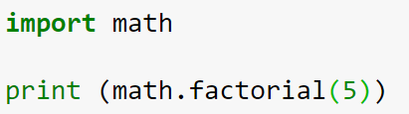
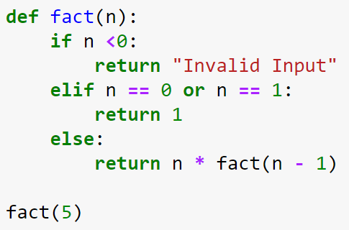
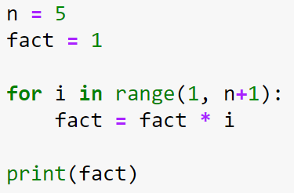
Factorial function
Built-in
Recursive function
For-loop

Slide 18
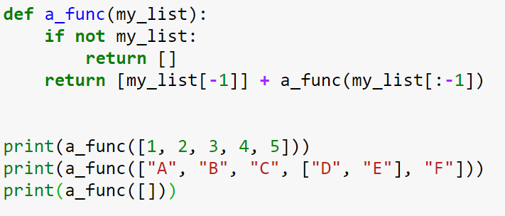
Class practice

Slide 19
Group discussion

Slide 20
Pascal’s triangle
Pascal’s triangle is a triangular array of the binomial coefficients.

Slide 21
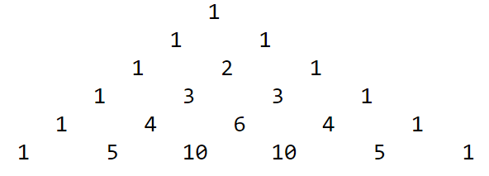
group practice
Consider the following Pascal’s triangle:
Write a program for Pascal’s triangle (only using iterative method).
Modify your program to use recursive method.

